Slide 1

Outfitmania

Slide 2
Problem statement:
OutfitMania is a web-based platform designed to address the contemporary challenge of enhancing the clothing shopping experience for users. The modern landscape of online clothing retail presents a challenge in delivering a comprehensive and engaging shopping experience to consumers. OutfitMania seeks to address these challenges by creating a user-centric platform that revolutionizes the online clothing shopping experience. It's like having your favorite shopping mall right at your fingertips, offering an endless selection of stylish outfits, from cozy casual wear to elegant formal attire. The platform brings the joy of shopping directly to you, providing an effortless and enjoyable experience where you can browse, select, and purchase the perfect clothing items that match your unique style and preferences. In simpler terms, OutfitMania is your one-stop digital shop, where you can explore, mix and match, and find the ideal outfit that makes you look and feel fantastic. It's like having a fashion-savvy friend who always knows the latest trends and helps you pick out the best clothing options, but conveniently available at any time, from anywhere. This project aims to redefine the way people engage with fashion, making the process of discovering and buying clothing not just a transaction, but a delightful experience that celebrates individual style and comfort.

Slide 3




Technologies used:
HTML: It is used to define the layout, elements, and content structure, such as headers, paragraphs, lists, images, and links.
CSS: CSS is utilized to style the HTML elements, defining the visual layout, appearance, and responsiveness of the website.
JavaScript: JavaScript is employed to add interactive elements and dynamic features to the website. This includes functionalities such as sliders, dropdowns, form validation, and other user interface interactions.
Bootstrap: Bootstrap's components and utilities are used to maintain consistency and streamline the design process. Elements such as navigation bars, cards, modals, and forms are integrated to ensure a unified and professional appearance throughout the website.

Slide 4


1. Project Structure:
HTML Pages: Created a well-organized structure for essential pages including Home, Men, Women, Accessories, About Us, and Signup modal with Buy Now modal functionality.
CSS Styling: Implemented external CSS for each page to ensure a consistent and visually appealing design.
Cohesive Navigation: Ensured a cohesive layout across pages for a seamless user navigation experience.
2. JavaScript Functionality:
Event Listeners: Utilized JavaScript to add event listeners for buttons, enhancing the interactivity of the website.
Discount Message: Implemented functionality to dynamically display discount messages, providing users with real-time information.
3. Bootstrap Integration:
Page Components: Employed Bootstrap components, specifically cards, for the Men, Women, and Accessories pages to showcase items with associated prices.
Modal Usage: Integrated Bootstrap modals for the Signup and Buy Now functionalities, enhancing user engagement and providing a seamless experience.
Project structure

Slide 5
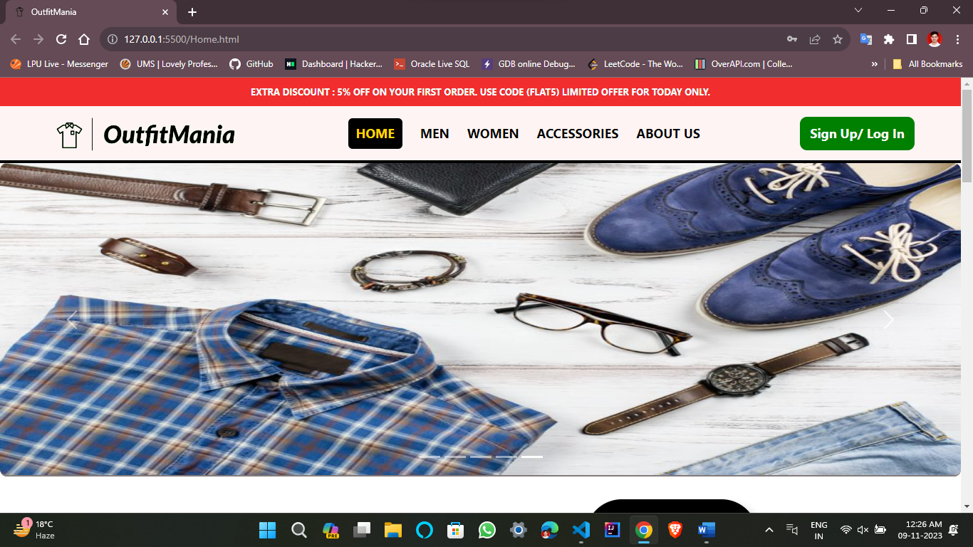
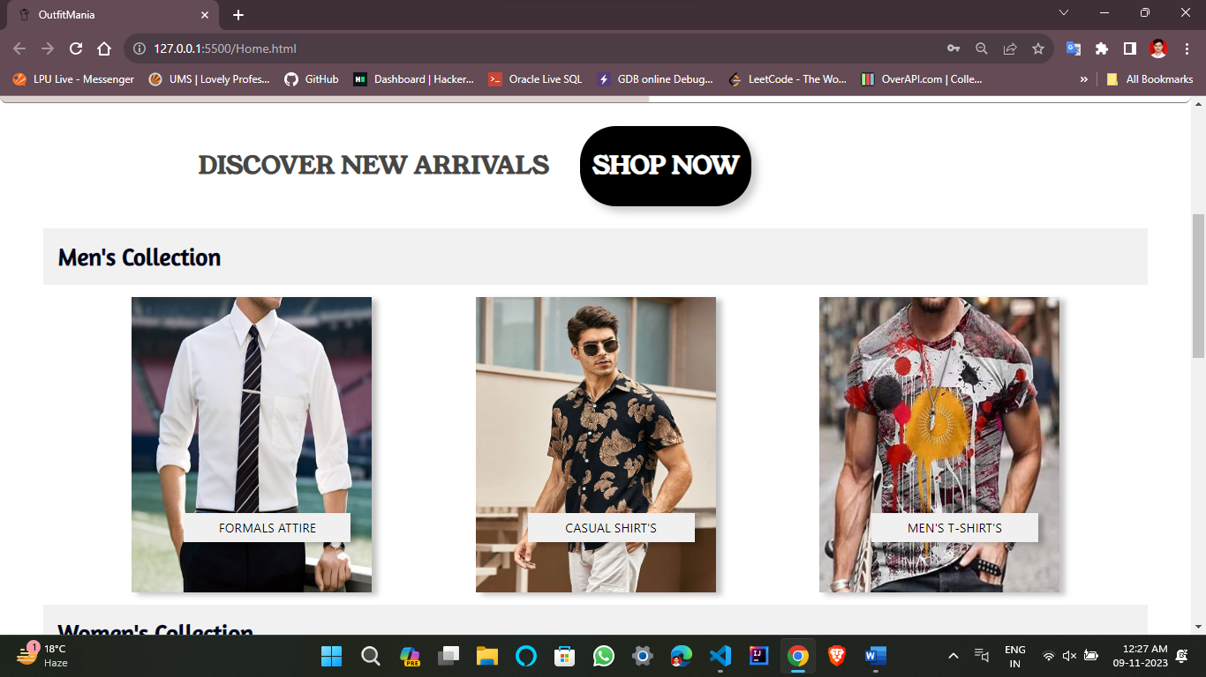
Home.html

Slide 6
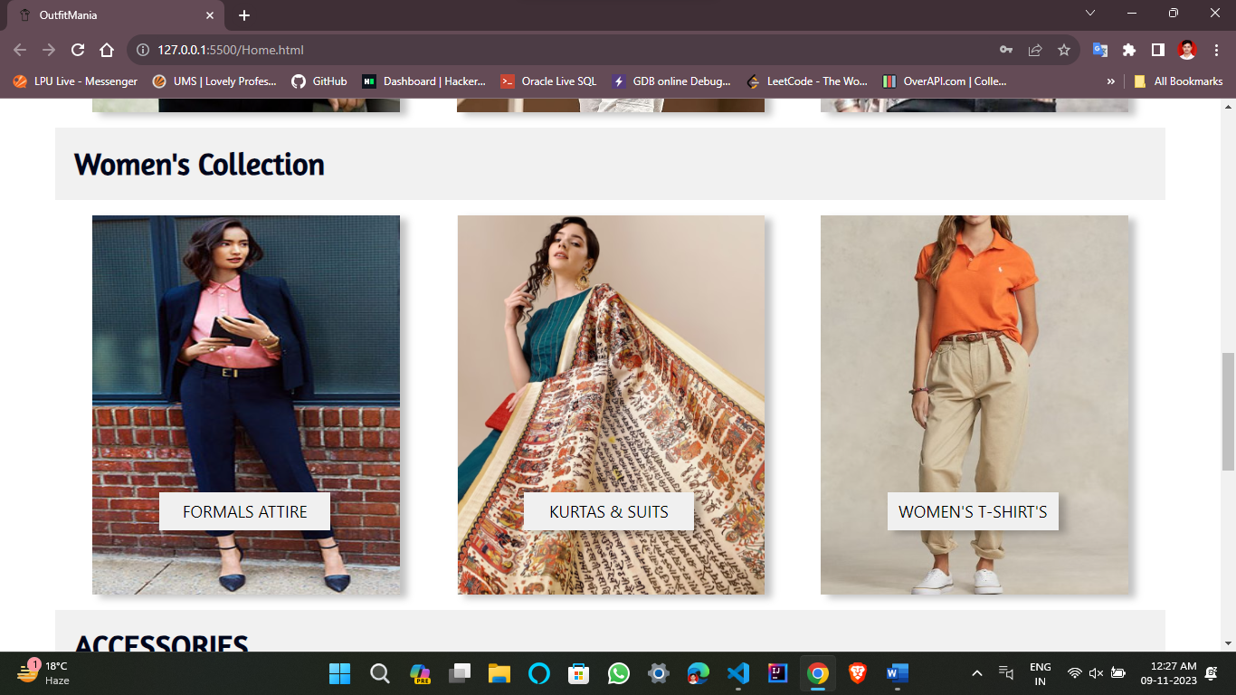
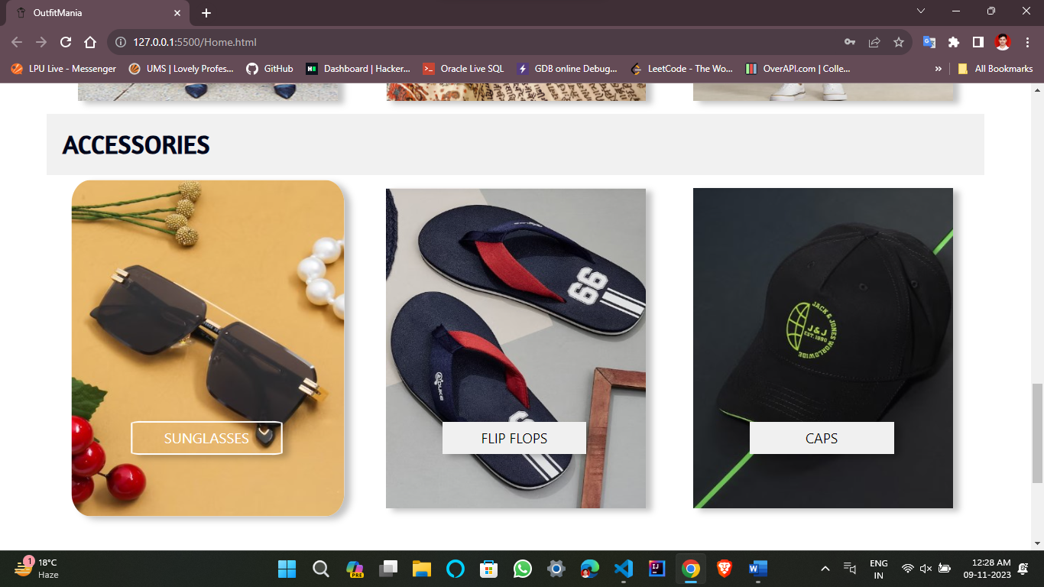
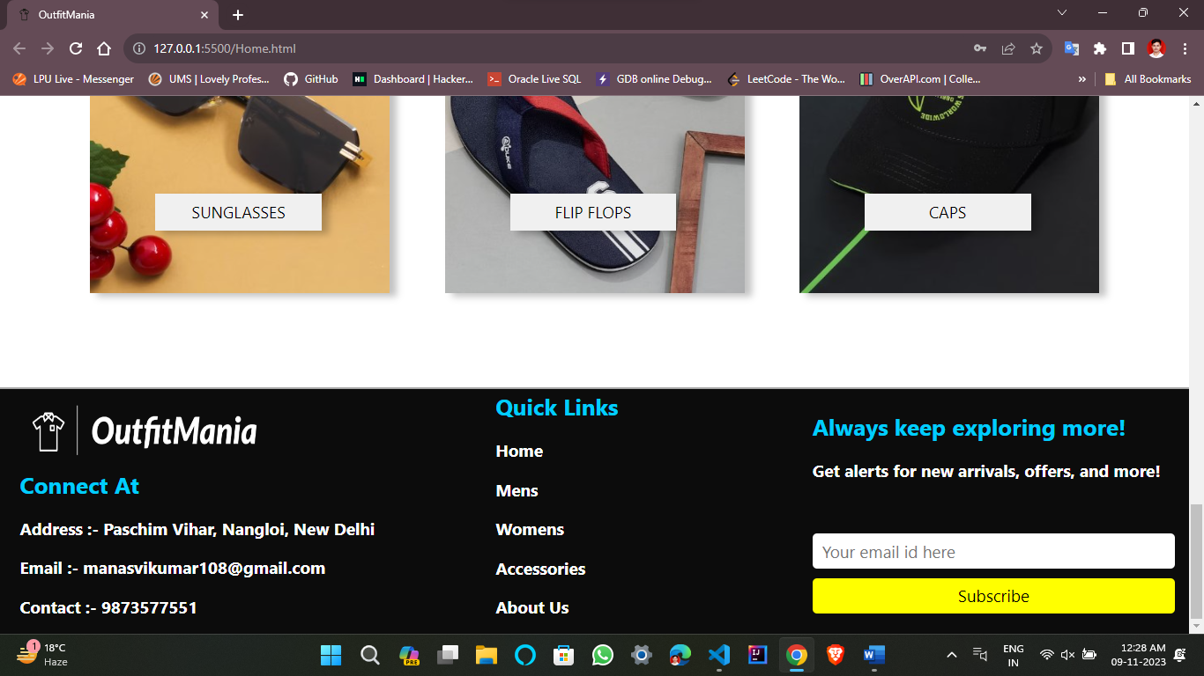

Slide 7
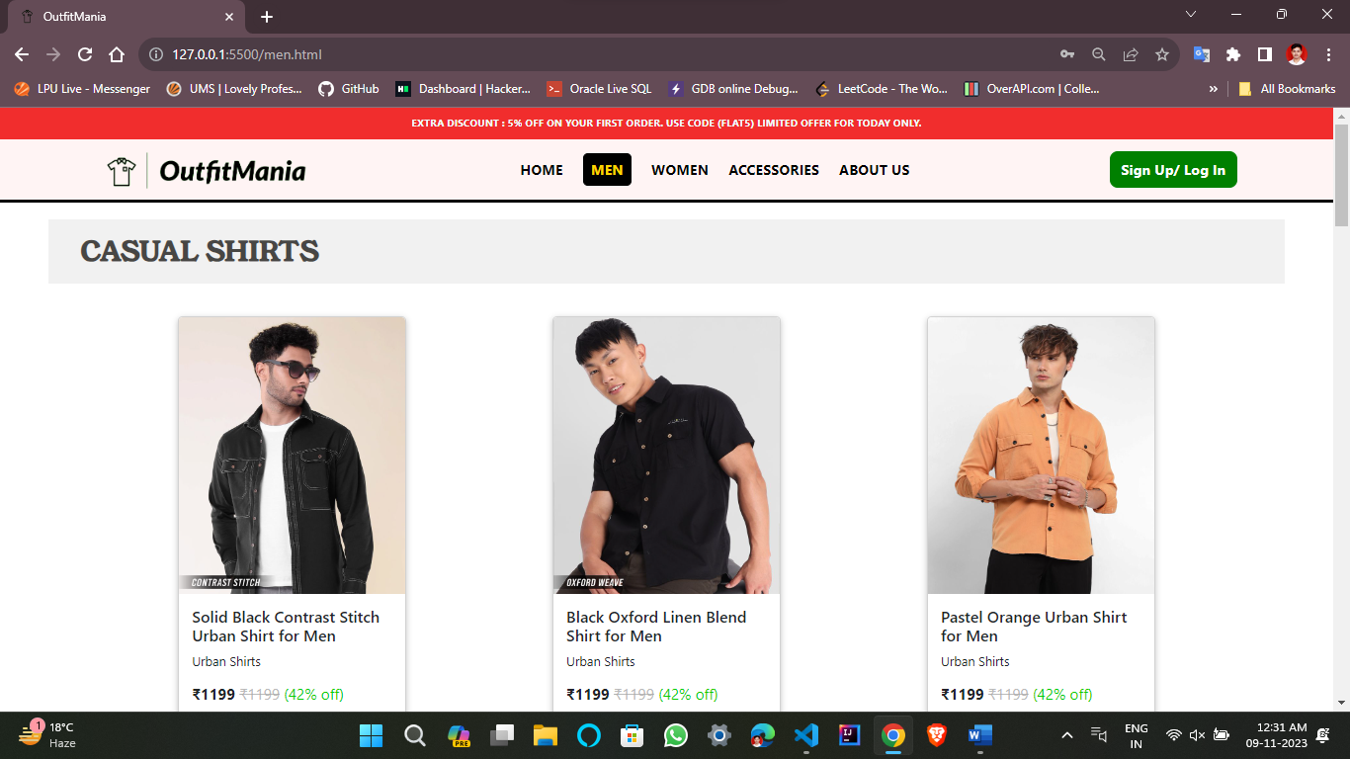
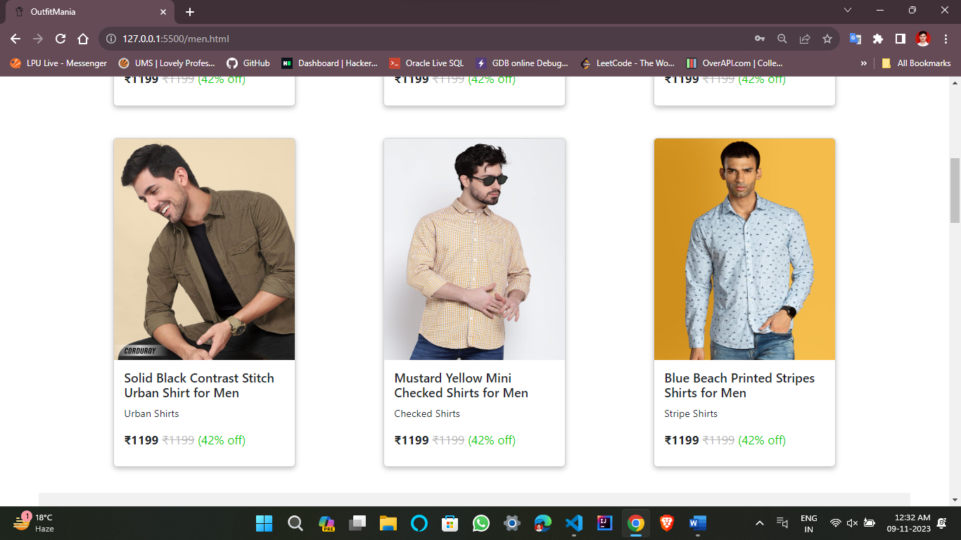
men.html

Slide 8
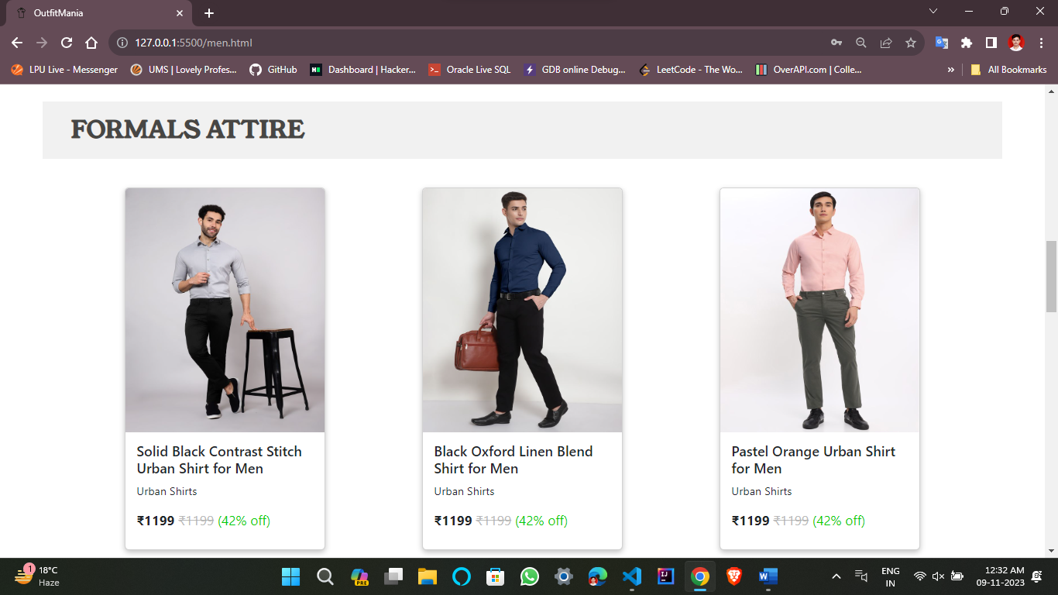
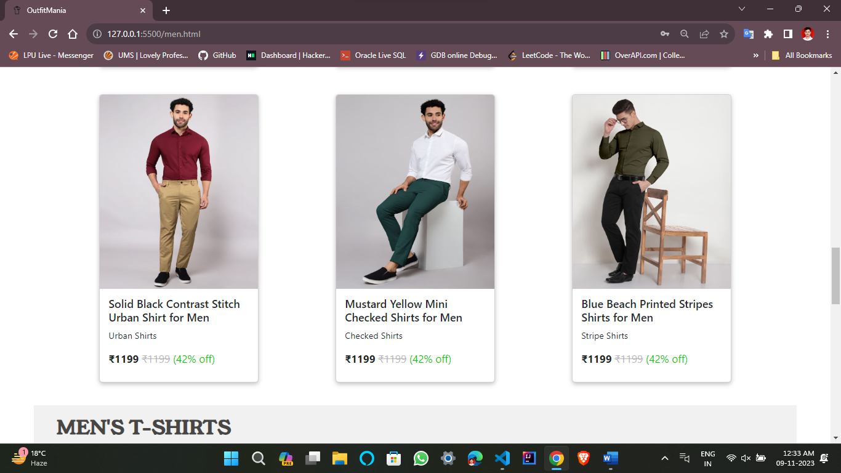
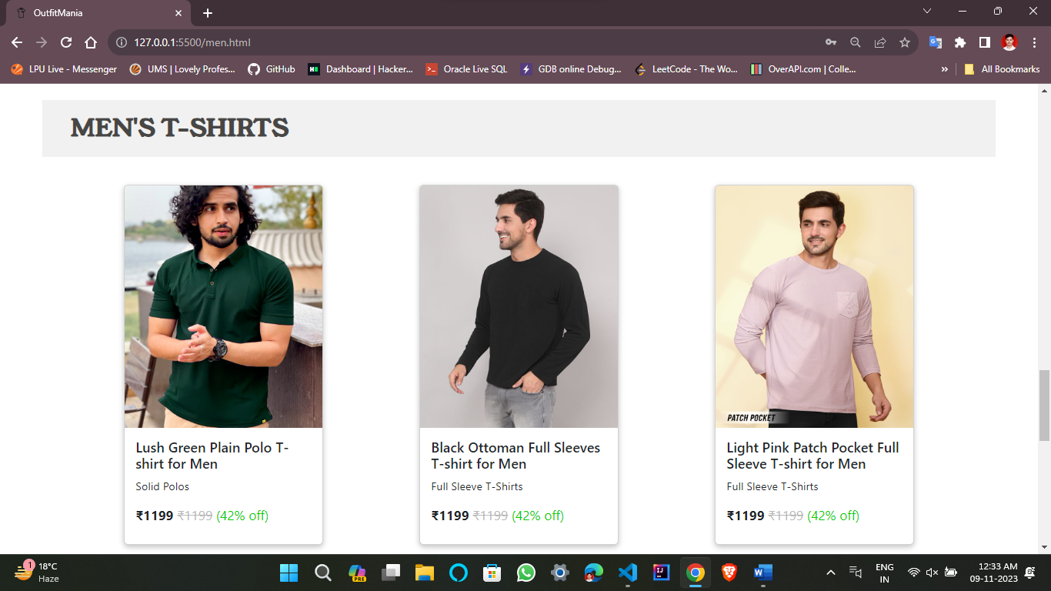
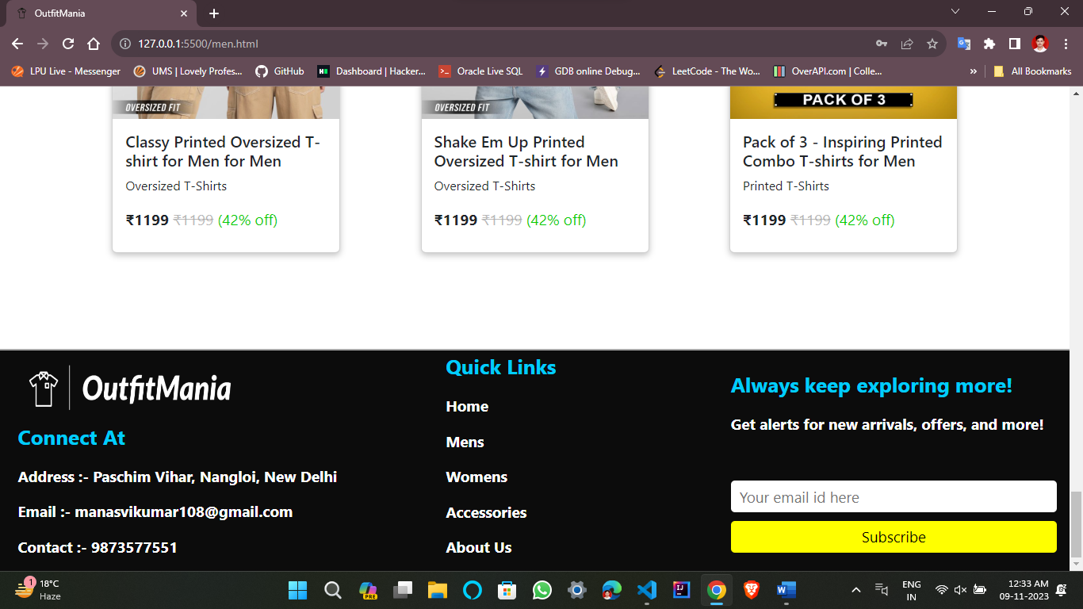

Slide 9
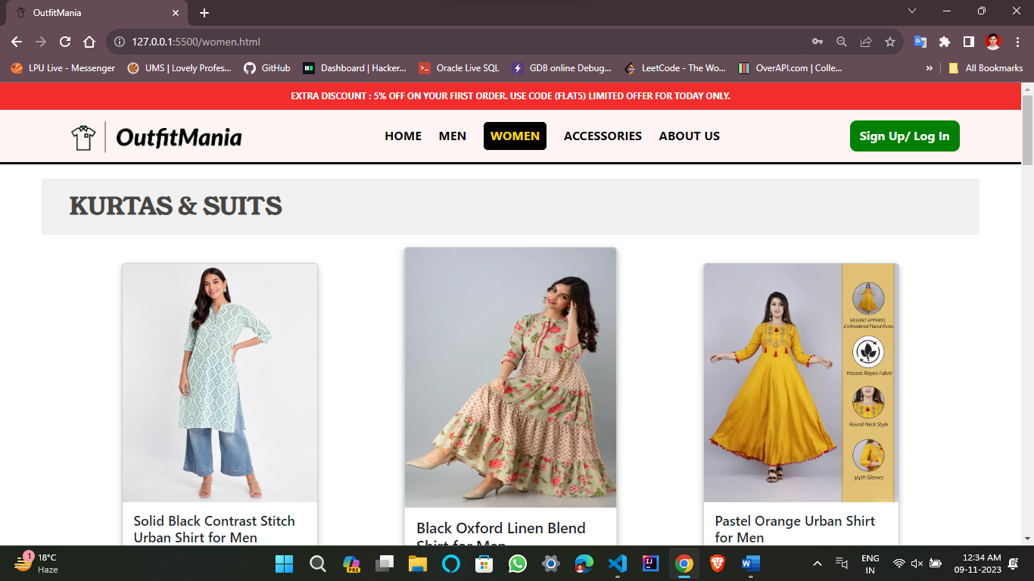
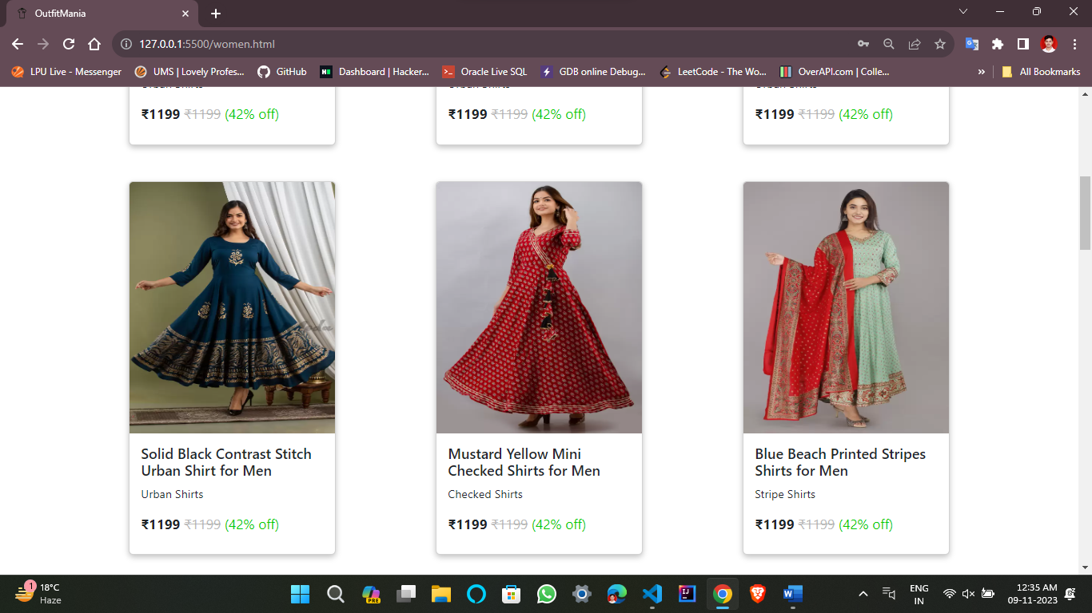
women.html

Slide 10
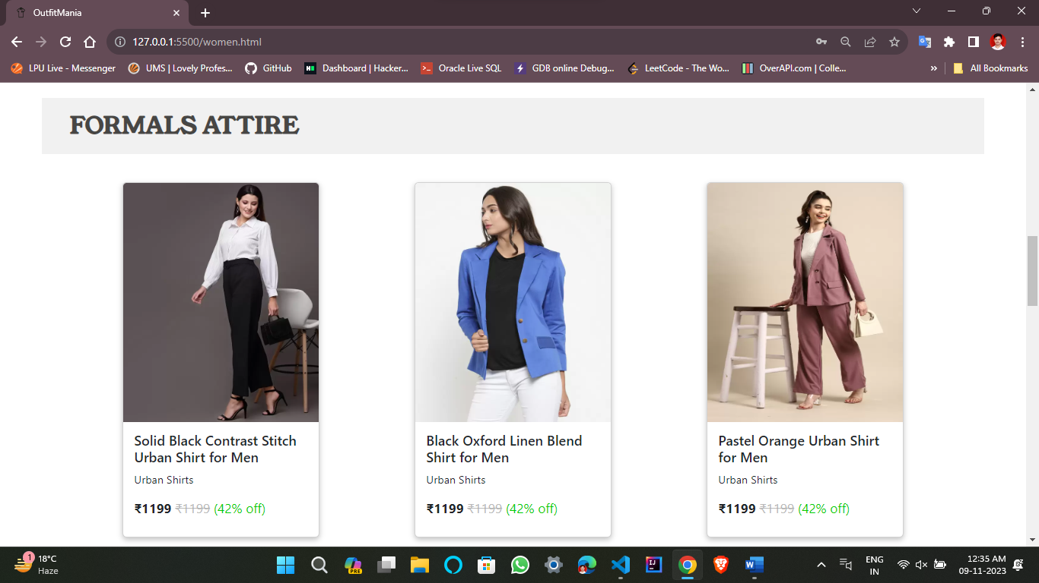
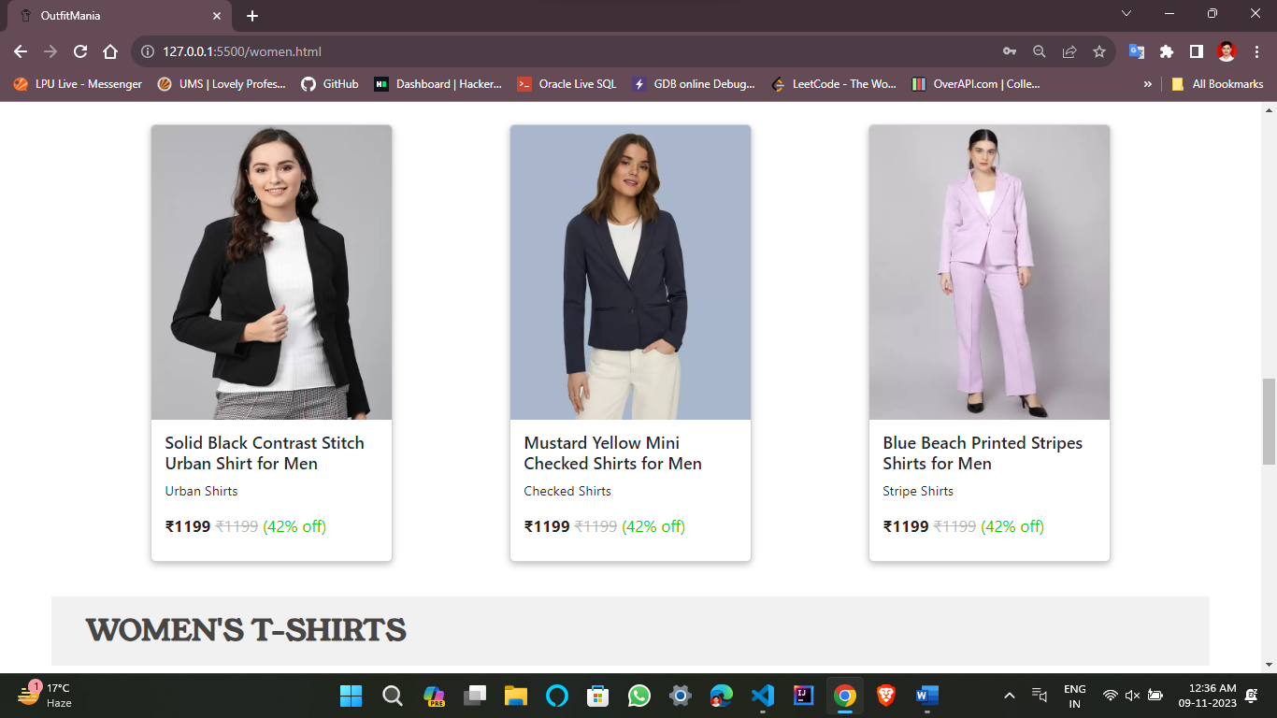
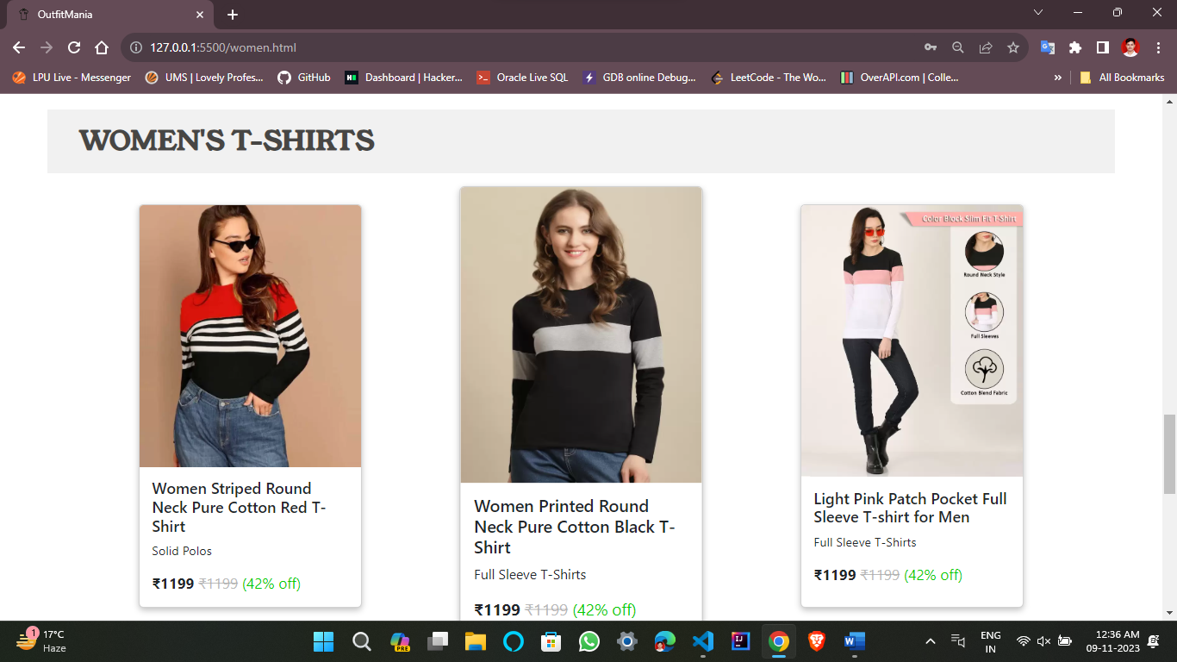
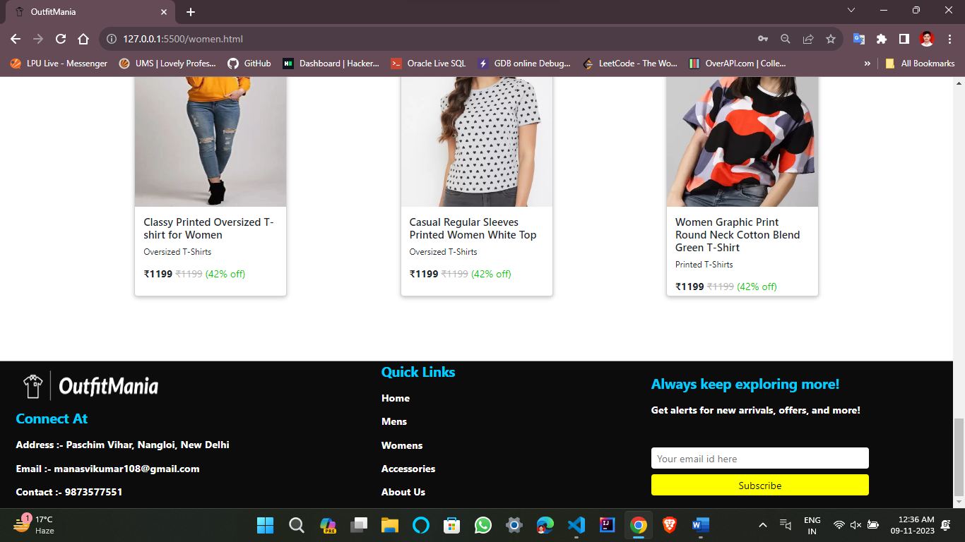

Slide 11
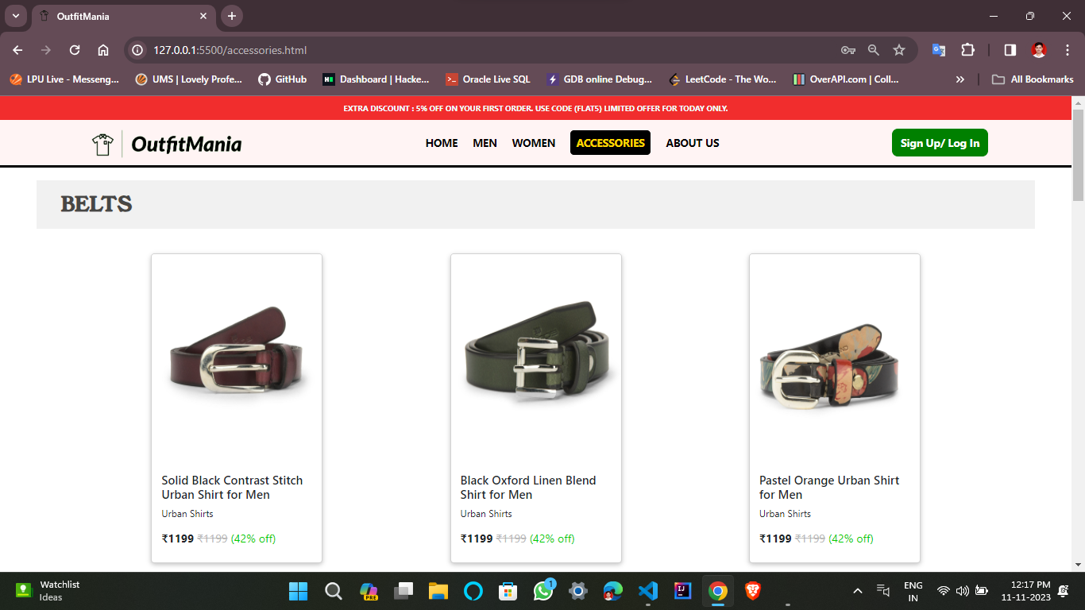
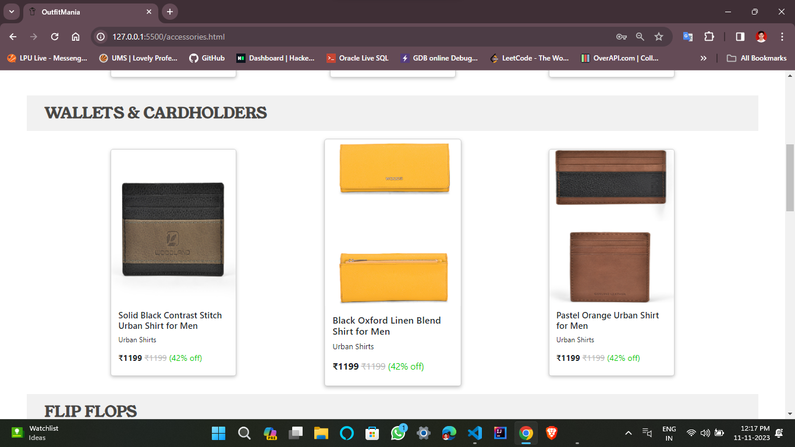
accessories.html

Slide 12
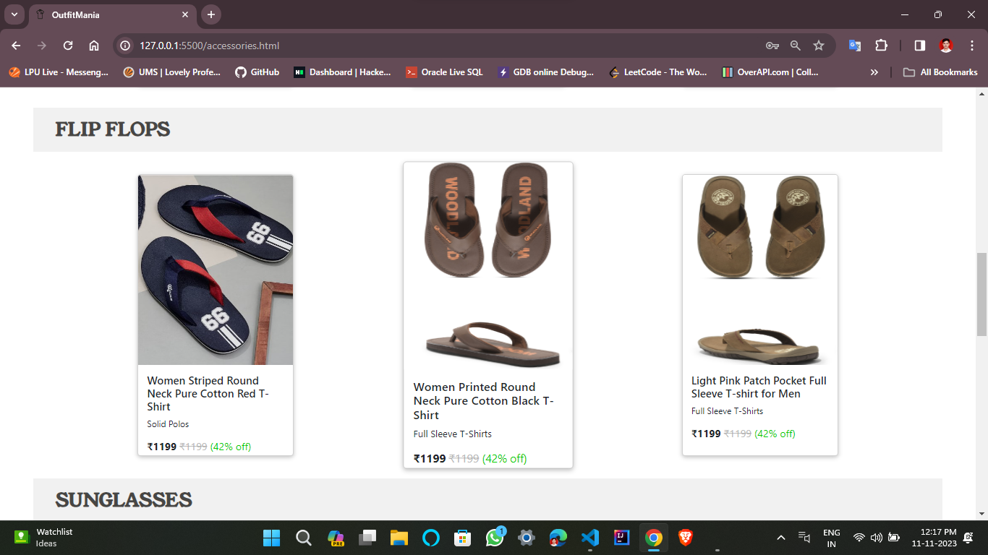
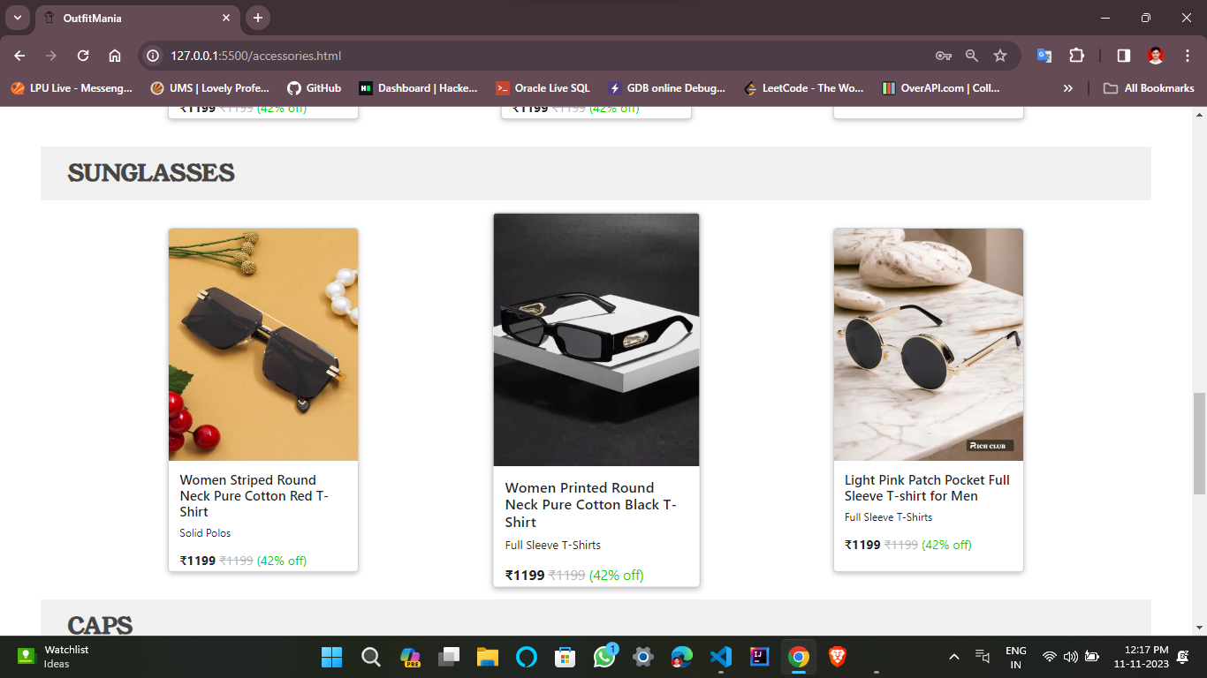
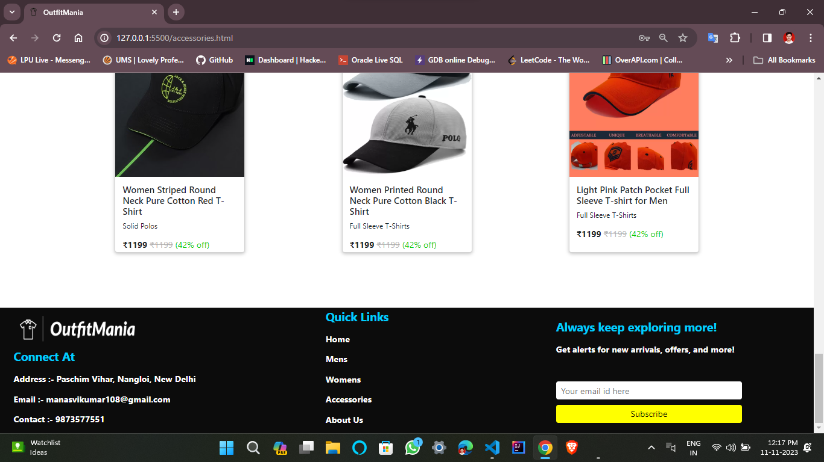

Slide 13
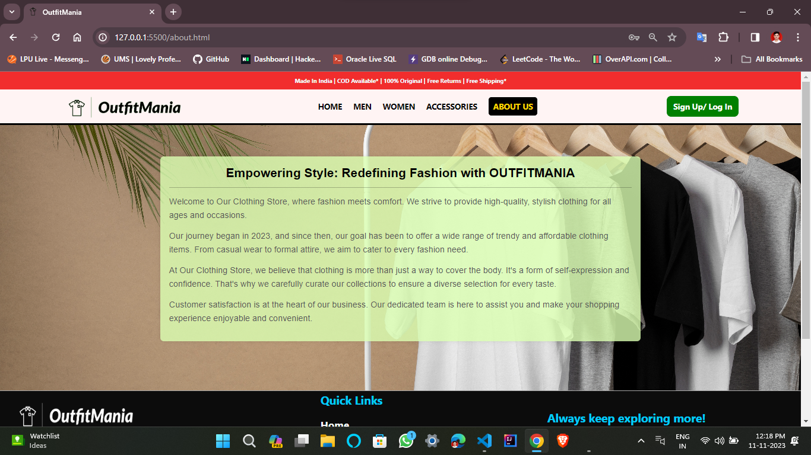
Aboutus.html

Slide 14
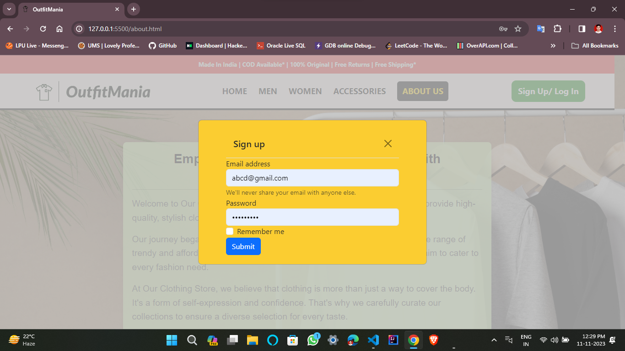
signup.html

Slide 15
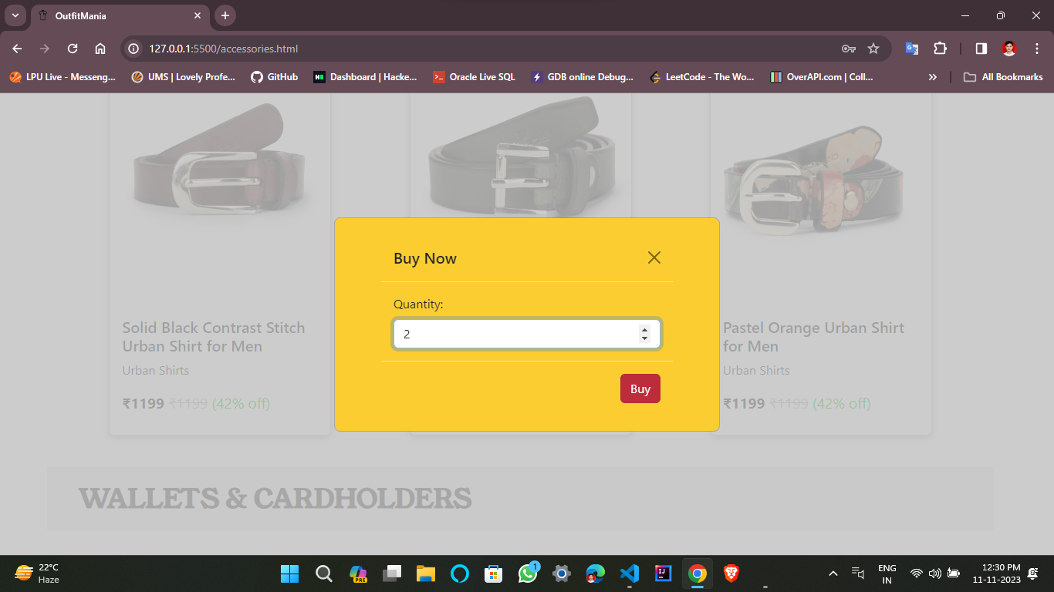
buynow.html

Slide 16
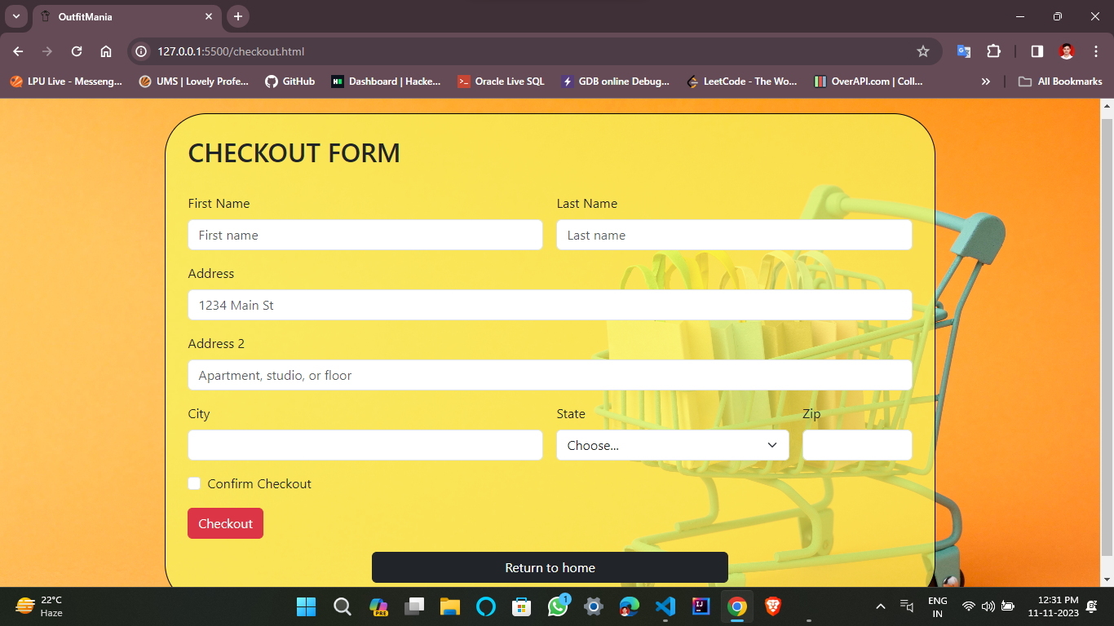
checkout.html

Slide 17
Thank You

